Slide 1
AI for Coral reefs
Image segmentation

Slide 2

The team
Maks Kulicki
MSc Student in Artificial Intelligence
Amsterdam, the Netherlands
Mark Halverson
PhD Physical Oceanography
Vancouver, BC, Canada

Slide 3
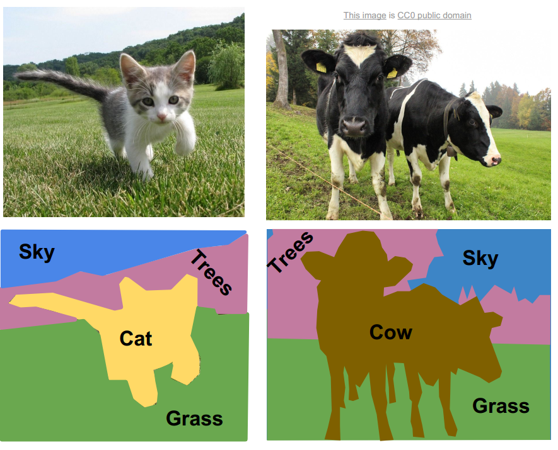
The problem
Object segmentation - figuring out what is where in a picture
Using that to calculate coral cover

Slide 4
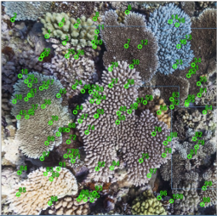
Dataset
Images with random point annotations
Problem - no segmentation labels given

Slide 5
Approaches explored
Unsupervised segmentation - not good enough on its own
Supervised - no segmented data available
Final approach - built using the classification model and Simple Linear Iterative Clustering (SLIC)

Slide 6
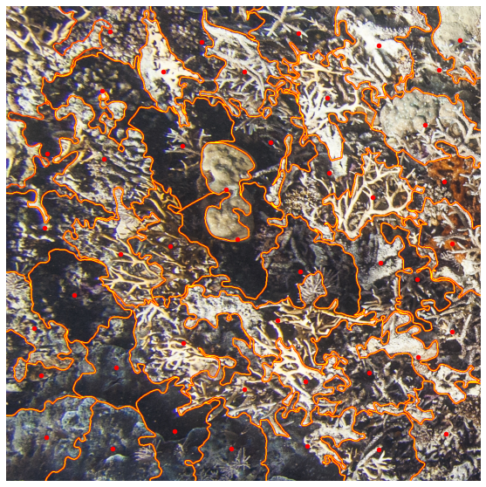
Find SLIC clusters and their centers

Slide 7
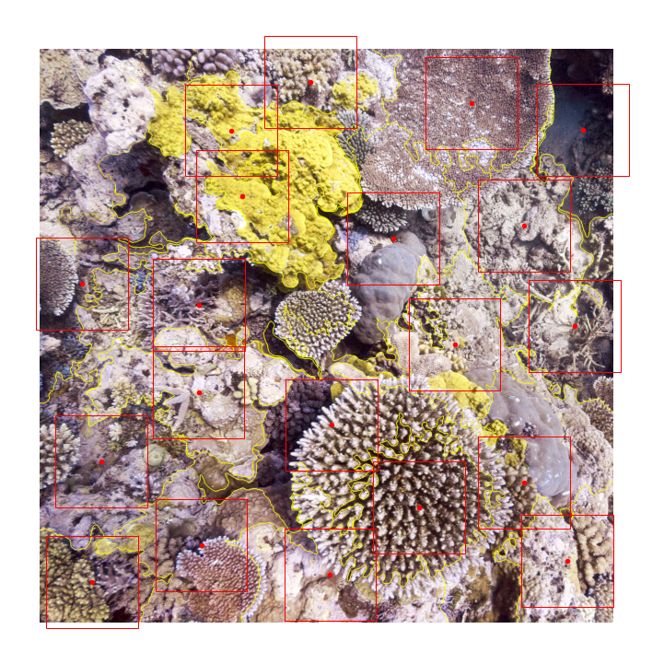
2. Classify the centers using square patches around them

Slide 8
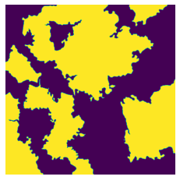
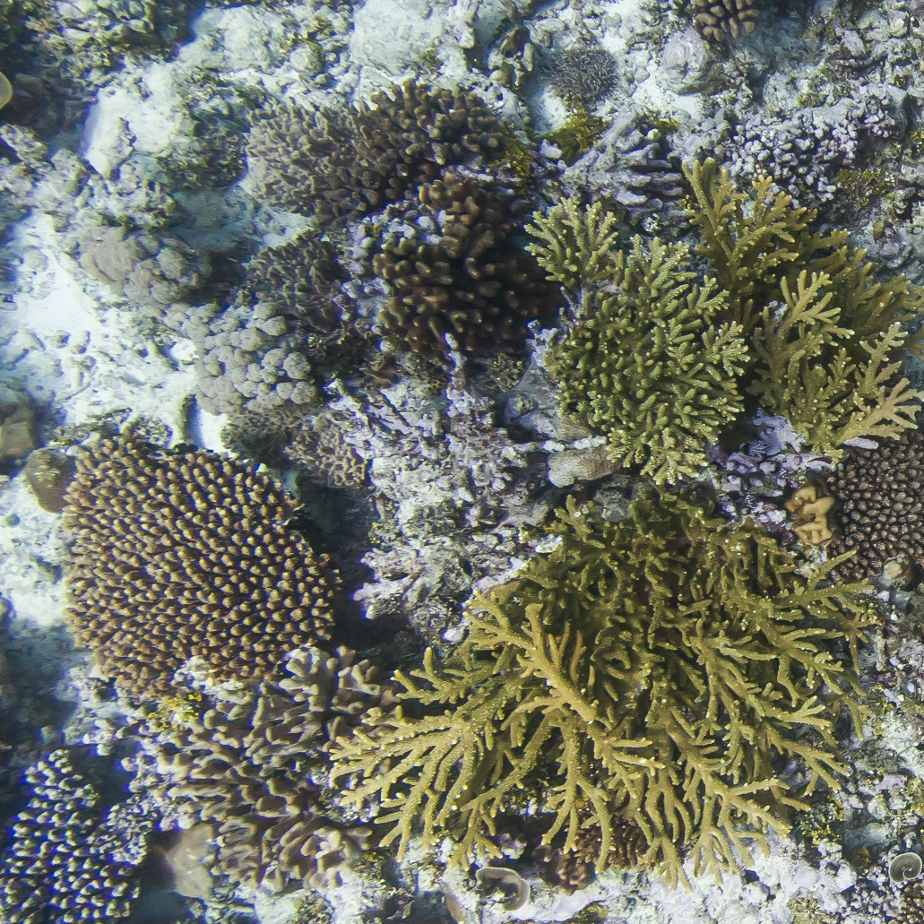
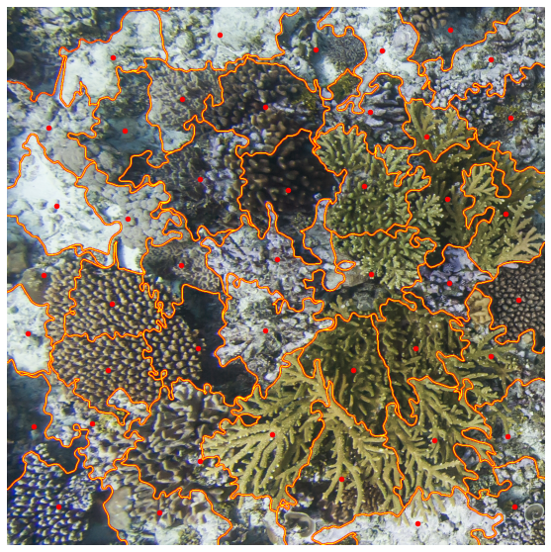
3. Apply labels to corresponding clusters
'Algae': 0.4787645078229587,
'Hard Coral': 0.5212354921770413}

Slide 9
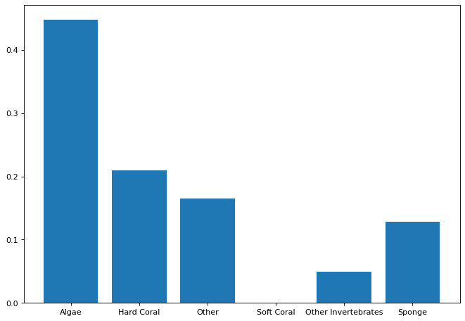
Results
Coverage calculated on a part of the IND/CHA dataset:

Slide 10
Advantages
Requires training only one model for the whole pipeline
Fine-grained object boundaries
Adjustable precision and running time by adjusting the number of clusters

